Slide 1

6th Grade Accelerated Math
Unit 13, Lesson 6 Writing Descriptions of Real-World Contexts from Algebraic Expressions Volume 2, pg. 291

Slide 2


Benchmark
MA.6.AR.1.1
Given a mathematical or real-world context, translate written descriptions into algebraic expressions and translate algebraic expressions into written descriptions.
volume 2, pg. 291

Slide 3
Integrated Mathematical Thinking and Reasoning Standards
MA.K12.MTR.1.1 Actively participate in effortful learning both individually and collectively.
MA.K12.MTR.2.1 Demonstrate understanding by representing problems in multiple ways.
MA.K12.MTR.4.1 Engage in discussions that reflect on the mathematical thinking of self and others.
MA.K12.MTR.5.1 Use patterns and structure to help understand and connect mathematical concepts.
MA.K12.MTR.7.1 Apply mathematics to real-world contexts.
volume 2, pg. 291

Slide 4

Learning Target
I can create a real-world context from an algebraic expression.
volume 2, pg. 291

Slide 5

Warm-Up
volume 2, pg. 291

Slide 6
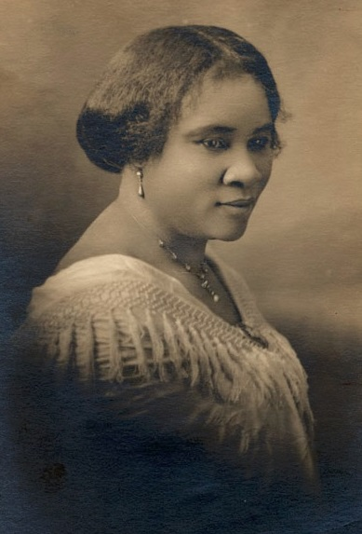
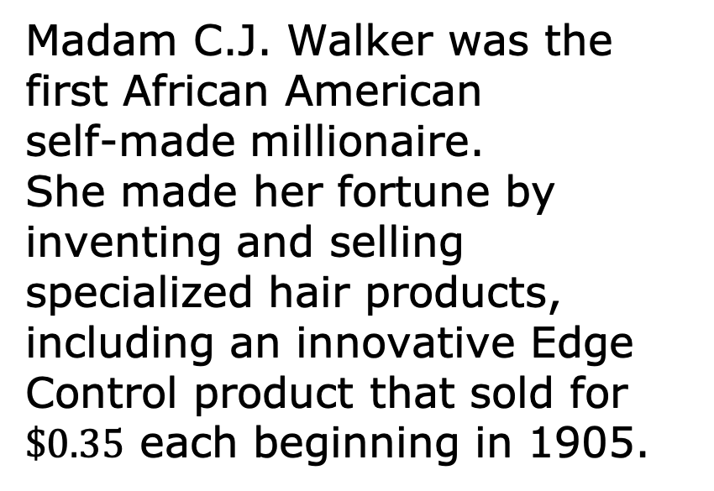
13.6.1 Warm-Up: Self-Made Millionaire
Madam C.J. Walker was the first African American self-made millionaire. She made her fortune by inventing and selling specialized hair products, including an innovative Edge Control product that sold for $\$0.35$ each beginning in 1905.
volume 2, pg. 291

Slide 7
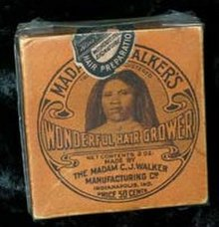
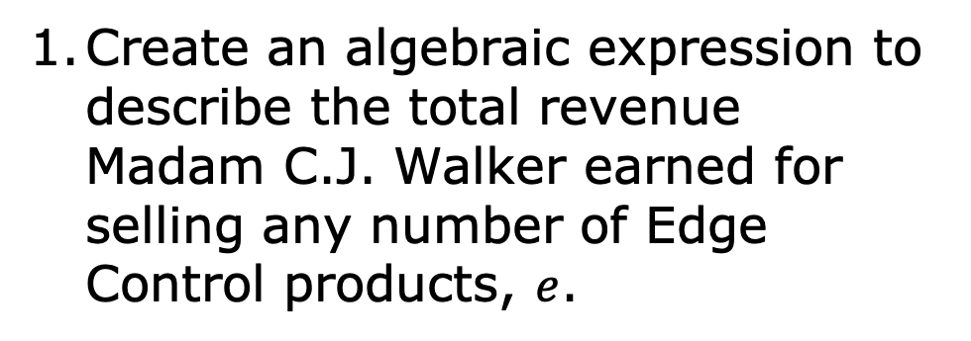
Create an algebraic expression to describe the total revenue Madam C.J. Walker earned for selling any number of Edge Control products, $e$.
volume 2, pg. 291

Slide 8

Activity
volume 2, pg. 292

Slide 9

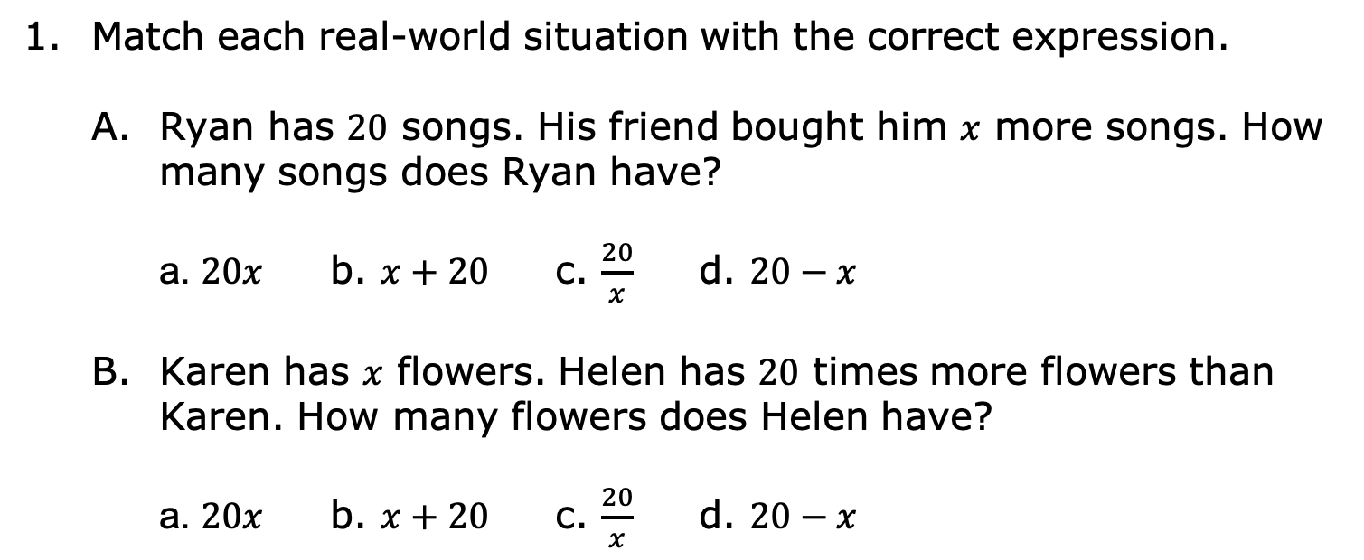
13.6.2 Activity: Matching Real-World Contexts to Expressions
Match each real-world situation with the correct expression.
Ryan has $20$ songs. His friend bought him $x$ more songs. How many songs does Ryan have?
a. $20x$ b. $x+20$ c. $\frac{20}{x}$ d. $20−x$
Karen has $x$ flowers. Helen has $20$ times more flowers than Karen. How many flowers does Helen have?
a. $20x$ b. $x+20$ c. $\frac{20}{x}$ d. $20−x$
volume 2, pg. 292

Slide 10
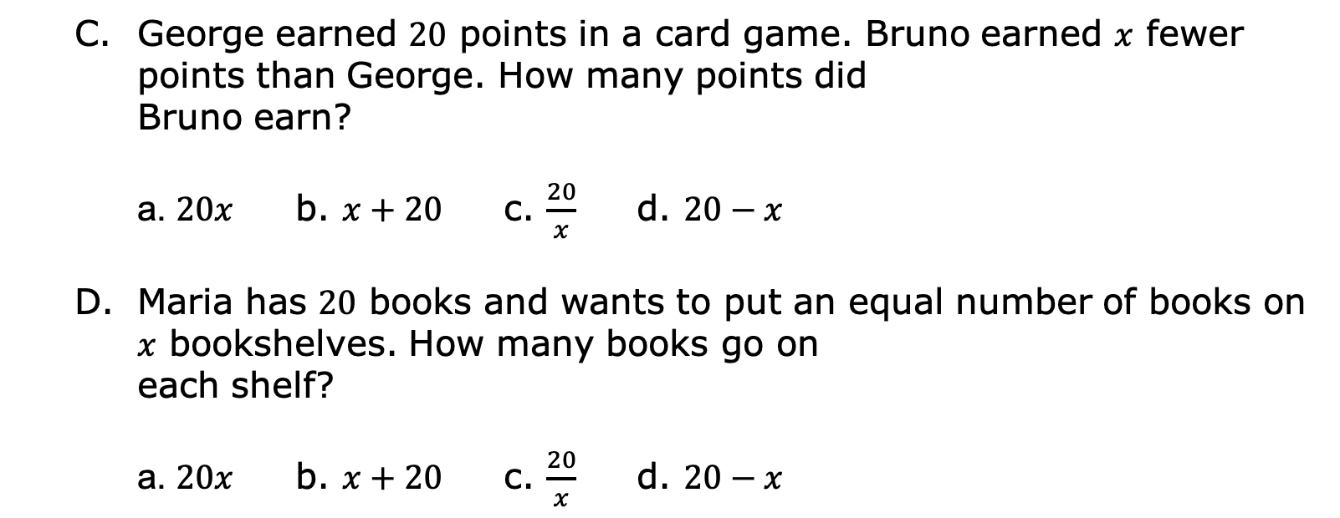
George earned $20$ points in a card game. Bruno earned $x$ fewer points than George. How many points did Bruno earn?
a. $20x$ b. $x+20$ c. $\frac{20}{x}$ d. $20−x$
Maria has $20$ books and wants to put an equal number of books on $x$ bookshelves. How many books go on each shelf?
a. $20x$ b. $x+20$ c. $\frac{20}{x}$ d. $20−x$
volume 2, pg. 292

Slide 11

Collaboration
volume 2, pg. 292

Slide 12

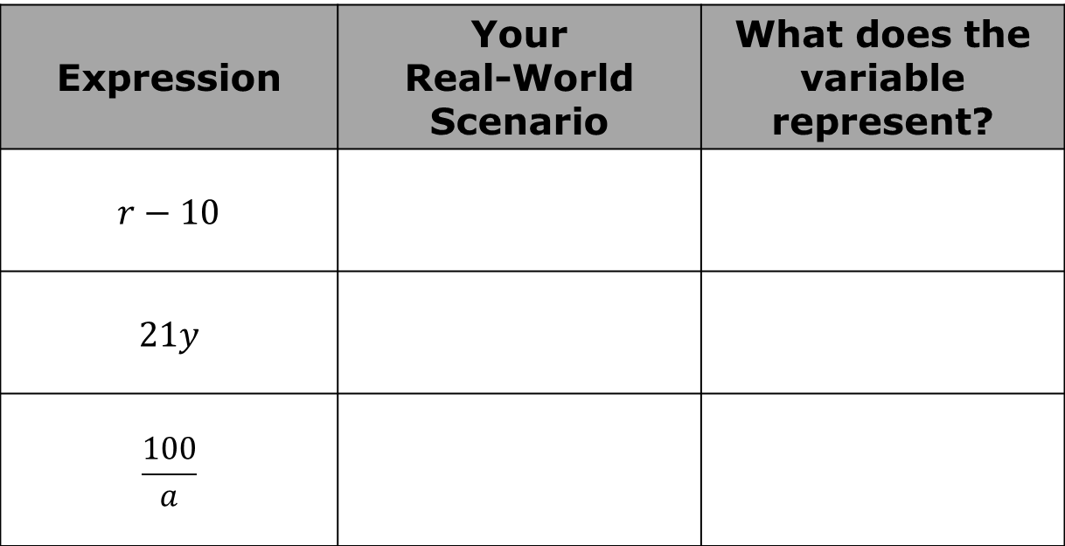
13.6.3 Collaboration: Writing Real-World Contexts
For each expression, create a real-world scenario that the algebraic expression could represent.
Expression | Your Real-World Scenario | What does the variable represent?
$$r−10$$
$$21y$$
$$\frac{100}{a}$$
volume 2, pg. 292

Slide 13
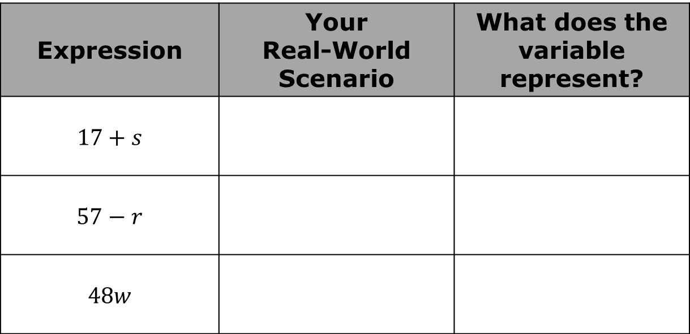
Expression | Your Real-World Scenario | What does the variable represent?
$$17+s$$
$$57−r$$
$$48w$$
volume 2, pg. 292

Slide 14
With your partner, pick four expressions from Question 1 and use them to complete the following table.
Expression | Your Partner’s Scenario | Does the Expression Accurately Represent the Scenario? | Similarities Between Your and Your Partner’s Scenarios for the Expression
 |  | Yes No
 |  | Yes No
volume 2, pg. 293

Slide 15
Expression | Your Partner’s Scenario | Does the Expression Accurately Represent the Scenario? | Similarities Between Your and Your Partner’s Scenarios for the Expression
 |  | Yes No
 |  | Yes No
volume 2, pg. 293

Slide 16
Activity
volume 2, pg. 293

Slide 17
13.6.4 Activity: Gallery Walk
Several scenarios are displayed. For each scenario, write an algebraic expression to match.
Scenario | Expression
volume 2, pg. 293

Slide 18
Scenario | Expression
volume 2, pg. 293

Slide 19

Wrap-Up
volume 2, pg. 294

Slide 20
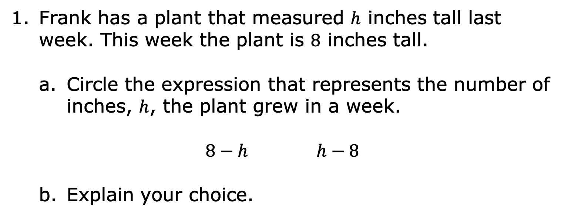
13.6.5 Wrap-Up: Ticket Out the Door
Frank has a plant that measured $h$ inches tall last week. This week the plant is $8$ inches tall.
Circle the expression that represents the number of inches, $h$, the plant grew in a week.
$8−h$ $h−8$
Explain your choice.
volume 2, pg. 294

Slide 21
For the expression not chosen, describe a real-world situation that the expression might represent.
volume 2, pg. 294

